Slide 1
Software Quality Engineering
Lecture 1
Part II-software testing
Functional testing
alina.arshad@nu.edu.pk

Slide 2
State Transition Testing
State transition testing a black box testing technique in which output are triggered by changes to input conditions or changes to state of the system.
In other word, test are designed to execute valid and invalid state transitions.
A dynamic testing technique, which is used when the system is defined in term of finite number of state and the transitions between the state are governed by the rule of system.
Write test cases from given software models using state transition diagrams/tables.
Many systems have a number of stable states and transitions from one stable state to another stable state. These machines are called “finite state machines”.

Slide 3
State Transition Testing
State transition testing is based on the fact that the same action will give different results depending on the initial state for this action.
The actions that lead from one state to another are called transitions.
When to use:
When the tester is trying to test sequence of events that occur in the application under test. I.e., this will allow the tester to test the application behavior for a sequence of input values.
When the system under test has a dependency on the events/values in the past.

Slide 4
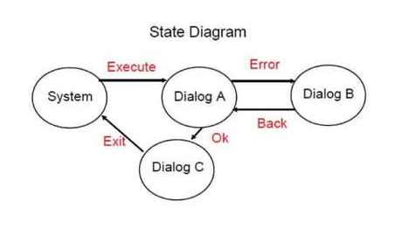
Example

Slide 5
Four Parts Of State Transition Diagram
There are 4 main components of the State Transition Model as below
1) States that the software might get
2) Transition from one state to another
3) Events An input (a message or method call)
4) Actions that result/output from a transition (an error message or being given the cash.)
1st try
Incorrect pin
Home page

Slide 6
State Transition Testing
This technique is based on the following steps:
identify the different stable states of the system, including temporary states, including the initial and final states;
for each state, identify the transactions, events, conditions, and actions that can be executed in this state;
model the system as a graph (or drawing) or as a table, in order to use it;
for each combination of state, event, and condition, verify the actions and resulting states.

Slide 7
Example 1:
Let’s consider an ATM system function where if the user enters the invalid password three times the account will be locked.
In this system, if the user enters a valid password in any of the first three attempts the user will be logged in successfully. If the user enters the invalid password in the first or second try, the user will be asked to re-enter the password. And finally, if the user enters incorrect password 3rd time, the account will be blocked.

Slide 8
State Transition Diagram
Incorrect pin
Incorrect pin
Start
1st try
2nd try
3rd try
Correct pin
Correct pin
Incorrect pin
Home page
Account locked

Slide 9
State Transition Table
Test cases | TC1 | TC2 | TC3 | TC4 | TC5 | TC6
State | S1 | S1 | S2 | S2 | S3 | S3
Input | Correct pin | Incorrect pin | Correct pin | Incorrect pin | Correct pin | Incorrect pin
Output | Home page | Second attempt | Home page | Third attempt | Home page | Account blocked
Finished state | S4 | S2 | S4 | S3 | S4 | S5

Slide 10
Activity
In the flight reservation login screen, consider you have to enter correct agent name and password to access the flight reservation application.
It gives you the access to the application with correct password and login name, but what if you entered the wrong password.
The application allows three attempts, and if users enter the wrong password at 4th attempt, the system closes the application automatically.

Slide 11
Advantages and Disadvantages
ADVANTAGE:
This testing technique will provide a pictorial or tabular representation of system behavior which will make the tester to cover and understand the system behavior effectively.
By using this testing, technique tester can verify that all the conditions are covered, and the results are captured
DISADVANTAGE:
The main disadvantage of this testing technique is that we can’t rely in this technique every time. For example, if the system is not a finite system (not in sequential order), this technique cannot be used.
Another disadvantage is that you have to define all the possible states of a system. While this is all right for small systems, it soon breaks down into larger systems as there is an exponential progression in the number of states.

Slide 12
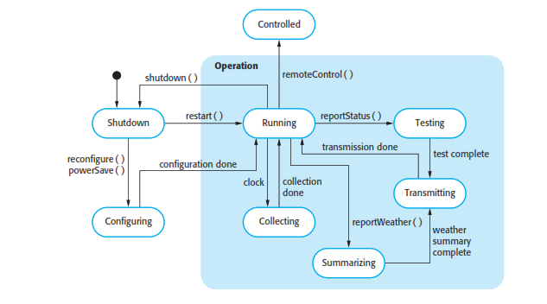
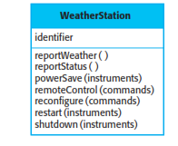
Weather station state diagram

Slide 13


Slide 14
Limitations and assumptions
The main assumptions with state transition testing are that we have identified all states and all transitions.
Any possible “un-identified” state or transition can lead to potential defects being left for the customer to find.

Slide 15
State Transition Testing
A graphical representation of states and transitions quickly becomes cluttered and difficult to visualize if the graph has too many states or transitions. It is then necessary to group many different sub-states and their transitions in separate graphs showing the operation of the sub-system, with its inputs and outputs.
To identify potentially forgotten actions, it is possible to explore the system by trying all possible actions at all the possible states.
Identification of the valid states and transitions allows identification of invalid or non-authorized transitions from that state.
It is thus possible to verify that the possible actions from that state do not allow execution of invalid transactions.
Identification of invalid transitions and actions must be envisaged to ensure that such transitions and states are indeed impossible.
Analysis of valid and invalid transitions, from all possible states of a system enables the design of test conditions, and sometimes identification of transitions that were not anticipated.

Slide 16
Any question????

